Slide 1



人工智能
罗平 luop@ict.ac.cn

Slide 2
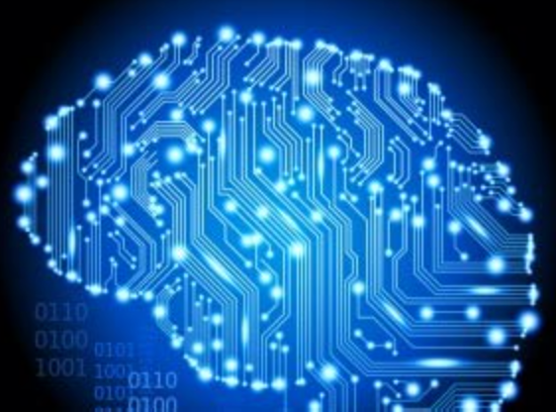
Knowledge 1

Slide 3
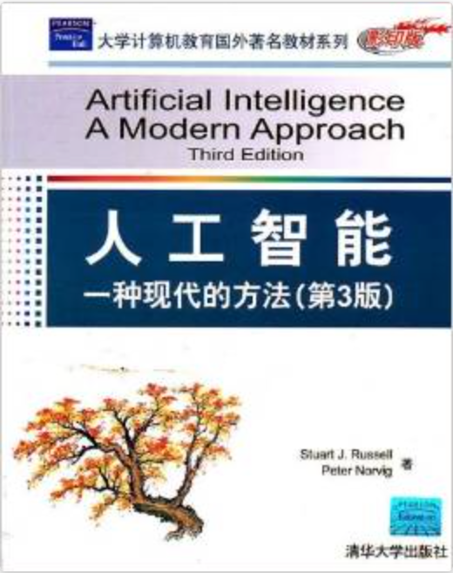
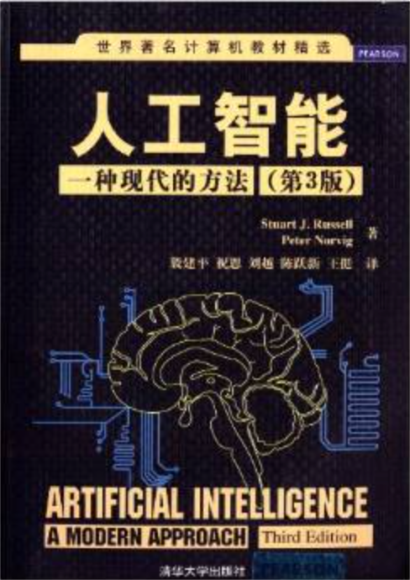
教材
http://www.ai-fundamental.com/
Materials on Knowledge
课程第二部分：
台湾大学 于天立教授 “人工智慧”课程
链接: http://pan.baidu.com/s/1miec9jM 密码: 4fd4
http://aima.cs.berkeley.edu/
中英文版本对照阅读

Slide 4
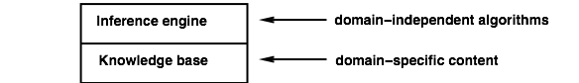
Knowledge bases
Knowledge base =set of sentences in a formal language
Declarative approach to building an agent(or other system):
TELL it what it needs to know
Then it can ASK itself what to do—answers should follow from the KB
Agents can be viewed at the knowledge level
i.e., what they know, regardless of how implemented
Or at the implementation level
i.e., data structures in KB and algorithms that manipulate them
只需要告知想知道什么

Slide 5
数理逻辑
《计算机科学的数理逻辑》
陆钟万著
授课视频：
http://www.1ketang.com/course/2025.html

Slide 6
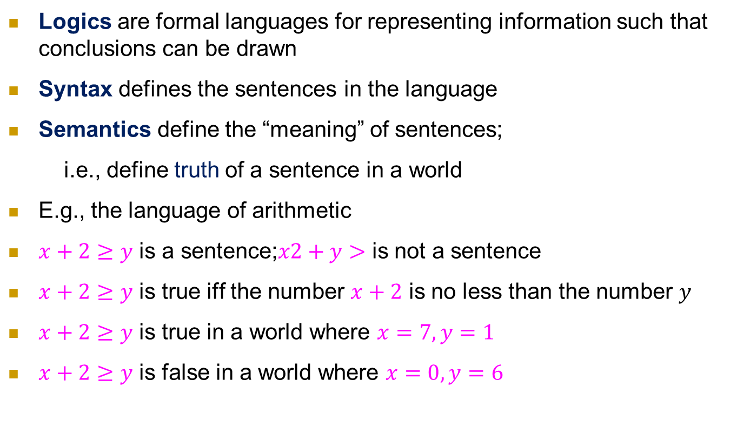
Logic in general
Logics are formal languages for representing information such that conclusions can be drawn
Syntax defines the sentences in the language
Semantics define the “meaning” of sentences;
i.e., define truth of a sentence in a world
E.g., the language of arithmetic
$x+2≥y$ is a sentence;$x2+y>$ is not a sentence
$x+2≥y$ is true iff the number $x+2$ is no less than the number $y$
$x+2≥y$ is true in a world where $x=7,y=1$
$x+2≥y$ is false in a world where $x=0,y=6$

Slide 7
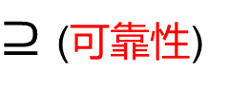
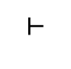
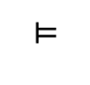
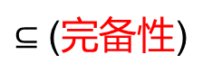
逻辑研究的内容
研究形式化定义的sentences之间的关系
两个角度：
语义：entailment 蕴含，逻辑推导
语法：deduction 演绎，形式推演
知识库
（sentences的集合，每个sentence符合
形式逻辑规定的语法）
$$⊨$$
$$⊢$$
新的知识库
（sentences的集合，语义上蕴含）
$⊆$ (完备性)
新的知识库
（sentences的集合，语法上推演）
$⊇$ (可靠性)

Slide 8
语义 Entailment （一般的定义）

Slide 9
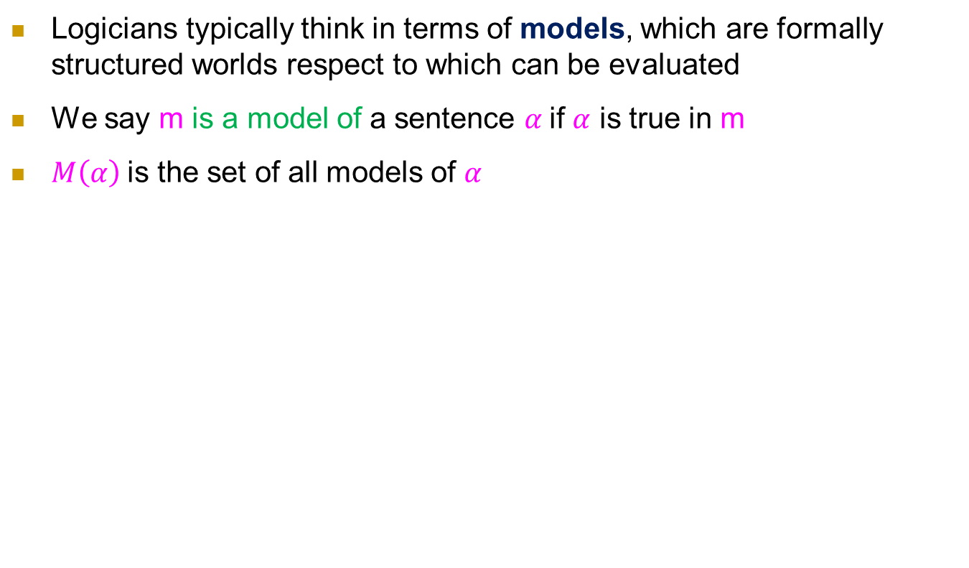
Model (模型), Truth Assignment (真值指派)
Logicians typically think in terms of models, which are formally structured worlds respect to which can be evaluated
We say m is a model of a sentence $α$if $α$ is true in m
$M\left(α\right)$is the set of all models of $α$
X+Y=4
X=0,Y=4是这个句子的model

Slide 10
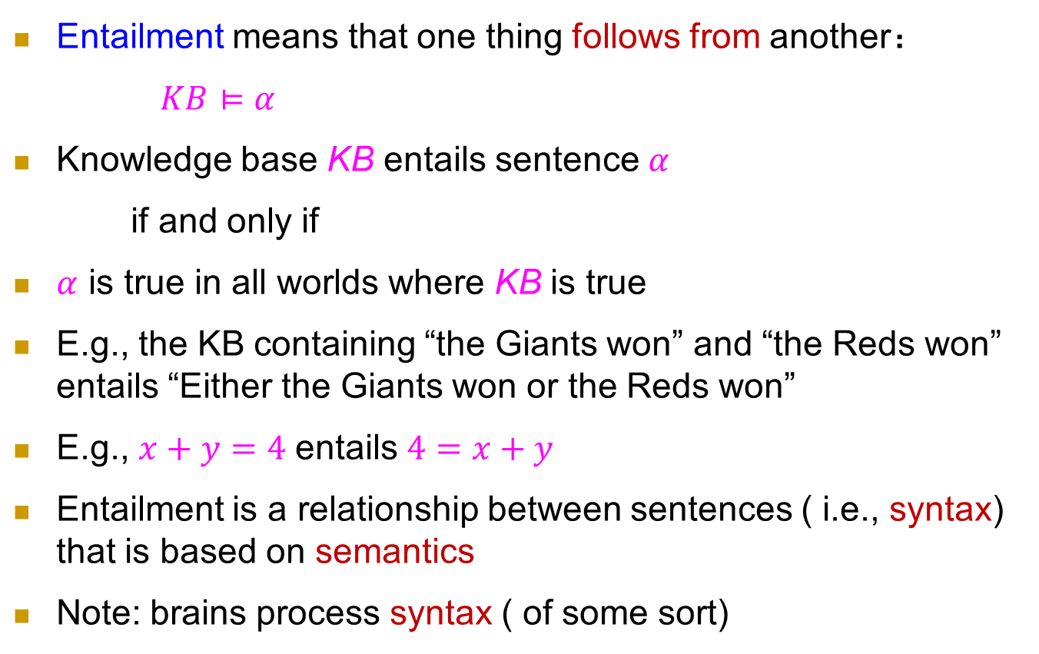
Entailment (蕴涵／蕴含)
语义：逻辑推导
Entailment means that one thing follows from another：
$KB⊨α$
Knowledge base KB entails sentence $α$
if and only if
$α$ is true in all worlds where KB is true
E.g., the KB containing “the Giants won” and “the Reds won” entails “Either the Giants won or the Reds won”
E.g., $x+y=4$ entails $4=x+y$
Entailment is a relationship between sentences ( i.e., syntax) that is based on semantics
Note: brains process syntax ( of some sort)

Slide 11
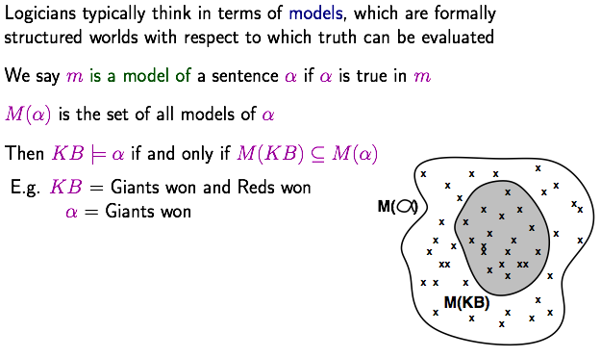
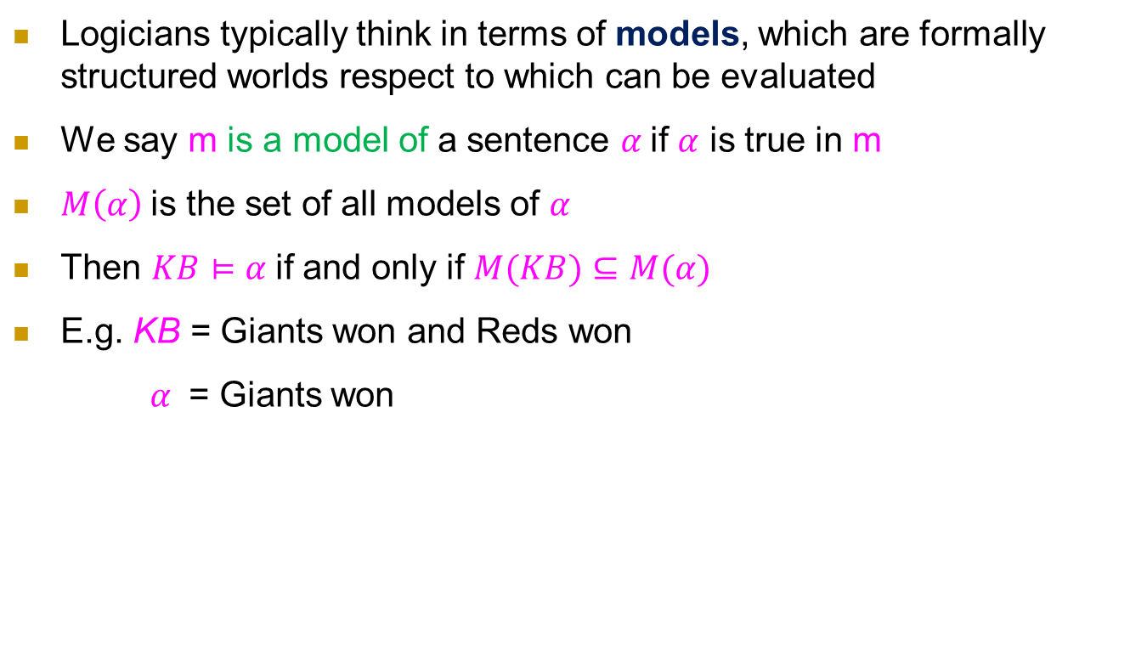
Model (模型)
Logicians typically think in terms of models, which are formally structured worlds respect to which can be evaluated
We say m is a model of a sentence $α$if $α$ is true in m
$M\left(α\right)$is the set of all models of $α$
Then $KB⊨α$if and only if $M(KB)⊆M(α)$
E.g. KB = Giants won and Reds won
$α$ = Giants won
Formal proof

Slide 12
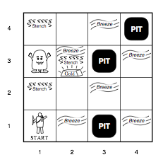
Wumpus World PEAS description
Performance measure
Gold +1000, death -1000
-1 per step, -10 for using the arrow
Environment
Squares adjacent to Wumpus are smelly
Squares adjacent to are breezy
Glitter iff gold is in the same square
Shooting kills Wumpus if you are facing it
Shooting uses up the only arrow
Grabbing picks up gold if in same square
Releasing drops the gold in same square
Sensors Breeze, Glitter, Smell
Actuators
Forward, Grab, Release, Shoot, Left turn, Right turn

Slide 13
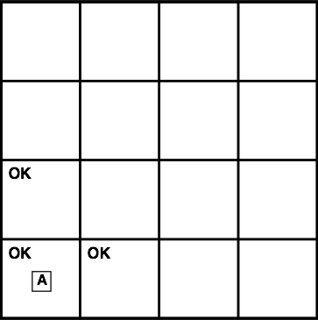
Exploring a wumpus world

Slide 14
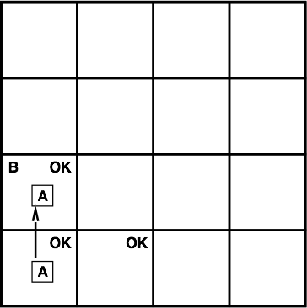
Exploring a wumpus world

Slide 15

Exploring a wumpus world

Slide 16
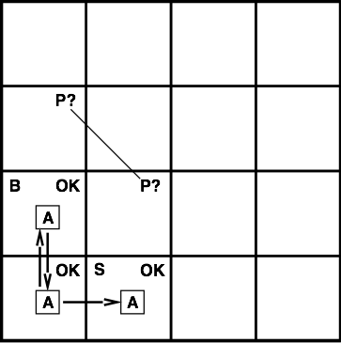
Exploring a wumpus world

Slide 17
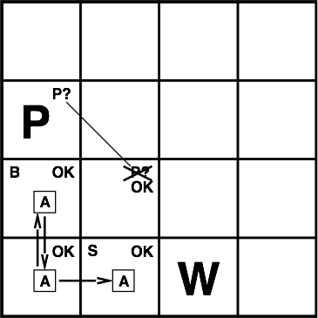
Exploring a wumpus world

Slide 18
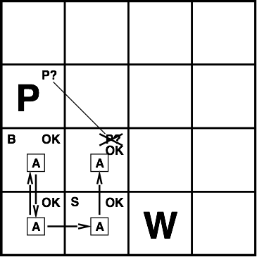
Exploring a wumpus world

Slide 19
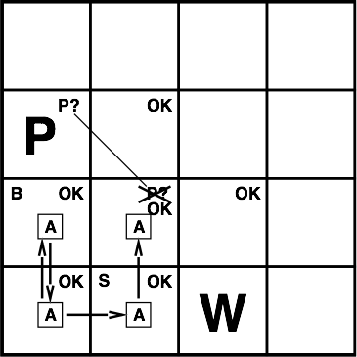
Exploring a wumpus world

Slide 20
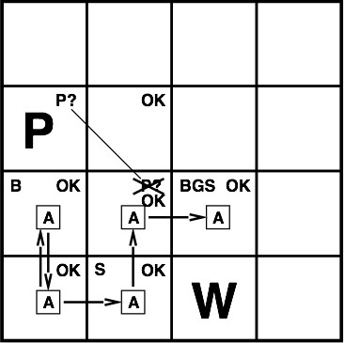
Exploring a wumpus world

Slide 21
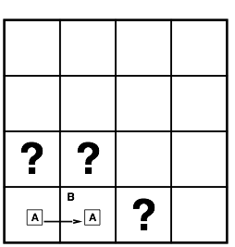
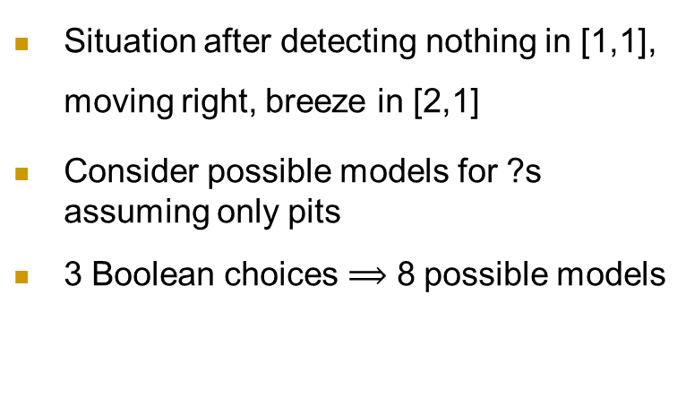
Entailment in the wumpus world
Situation after detecting nothing in [1,1], moving right, breeze in [2,1]
Consider possible models for ?s assuming only pits
3 Boolean choices $⟹$ 8 possible models

Slide 22
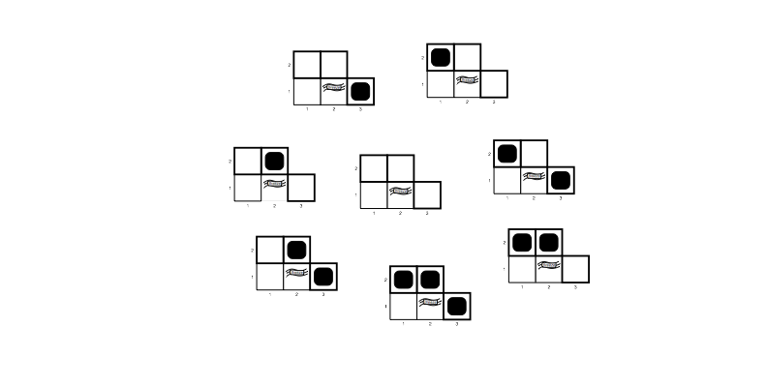
Wumpus models

Slide 23
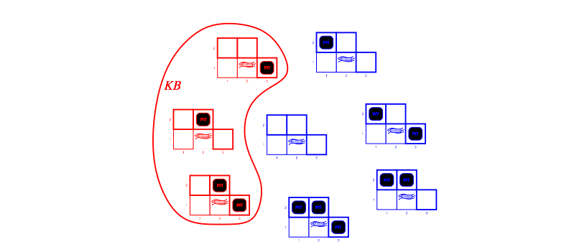
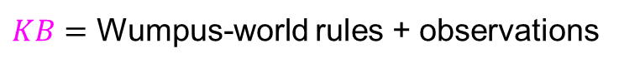
Wumpus models
$KB=$ Wumpus-world rules + observations

Slide 24
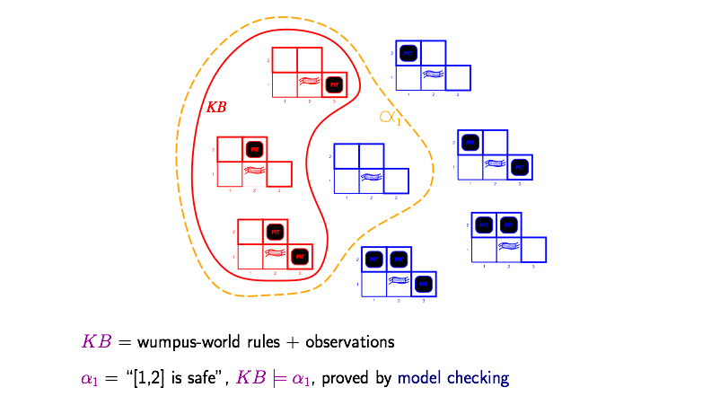
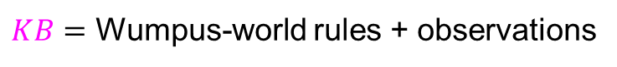
Wumpus models
$KB=$ Wumpus-world rules + observations
$α_{1}=$“[1,2] is not pit”, $KB⊨α_{1}$, proved by model checking

Slide 25
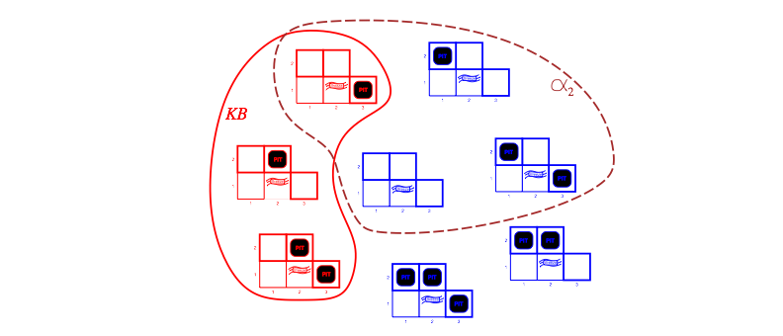
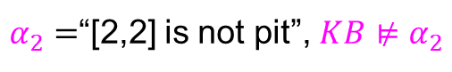
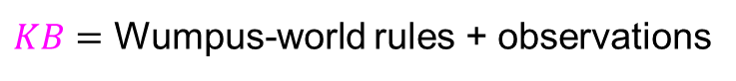
Wumpus models
$KB=$ Wumpus-world rules + observations
$α_{2}=$“[2,2] is not pit”, $KB⊭α_{2}$

Slide 26
Propositional logic: syntax and semantics

Slide 27
Propositional logic (命题逻辑): Syntax
Proposition: a declarative sentence that is either true or false
Propositional logic usually does not consider time
If the truth of a proposition varies over time, we call it fluent (“today is Monday”)
Atomic propositions (原子命题) are minimal propositions
Literals (文字) are atomic propositions or their negations

Slide 28
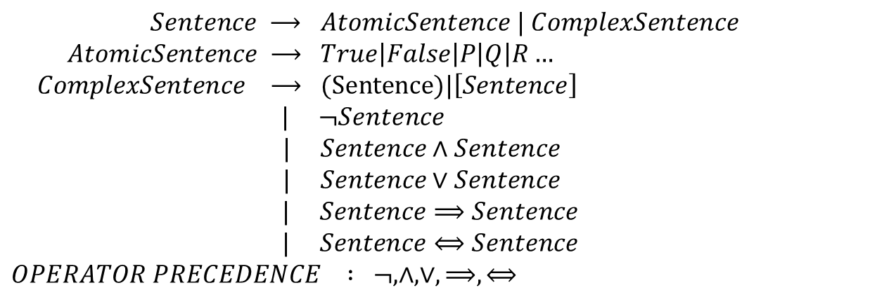
Propositional logic (命题逻辑): Syntax
Defined in Backus-Naur form (BNF)
$$Sentence ⟶ AtomicSentence | ComplexSentence$$
$$AtomicSentence ⟶ True\left|False\right|P\left|Q\right|R…$$
$$ComplexSentence ⟶ (Sentence)|\left[Sentence\right]$$
$$| ¬Sentence$$
$$| Sentence∧Sentence$$
$$| Sentence∨Sentence$$
$$| Sentence⟹Sentence$$
$$| Sentence⟺Sentence$$
$$OPERATOR PRECEDENCE : ¬, ∧,∨,⟹,⟺$$

Slide 29
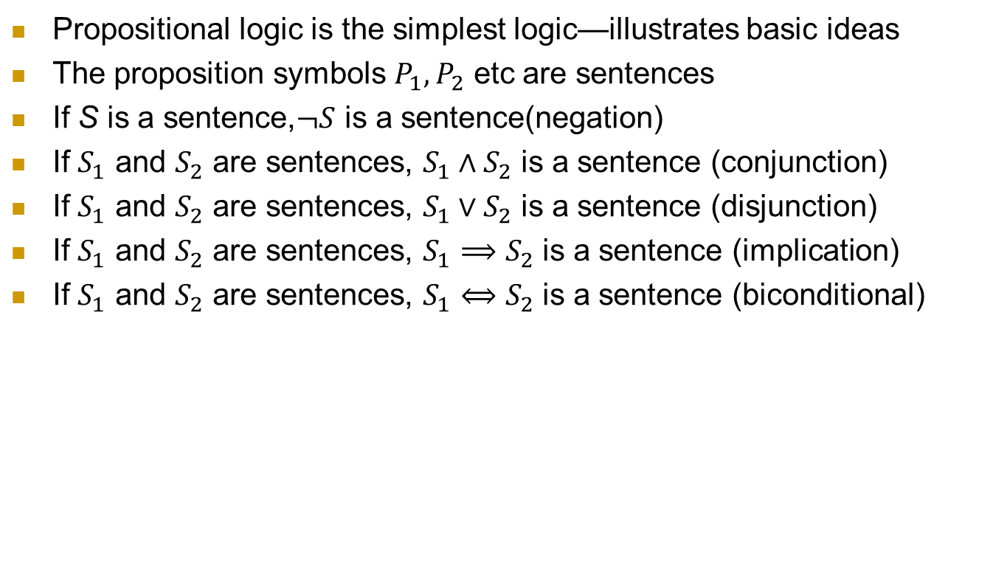
Propositional logic (命题逻辑): Syntax
Propositional logic is the simplest logic—illustrates basic ideas
The proposition symbols $P_{1},P_{2}$ etc are sentences
If S is a sentence,$¬S$ is a sentence(negation)
If $S_{1}$ and $S_{2}$ are sentences, $S_{1}∧S_{2}$ is a sentence (conjunction)
If $S_{1}$ and $S_{2}$ are sentences, $S_{1}∨S_{2}$ is a sentence (disjunction)
If $S_{1}$ and $S_{2}$ are sentences, $S_{1}⟹S_{2}$ is a sentence (implication)
If $S_{1}$ and $S_{2}$ are sentences, $S_{1}⟺S_{2}$ is a sentence (biconditional)

Slide 30
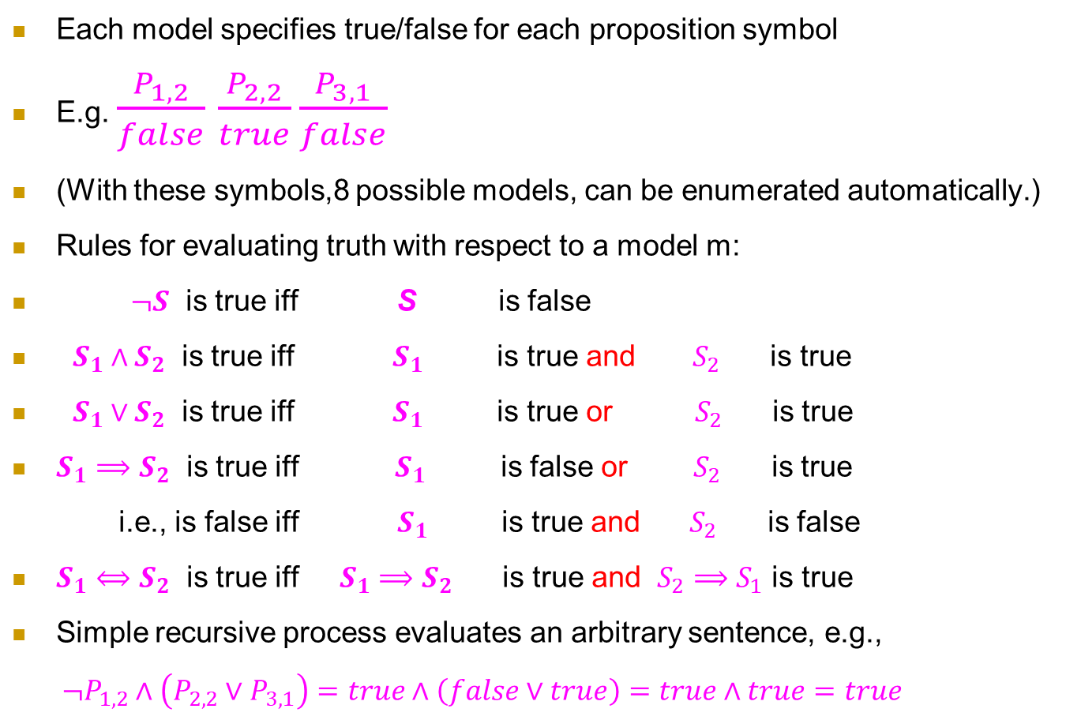
Propositional logic: Semantics
Each model specifies true/false for each proposition symbol
E.g. $\frac{P_{1,2}}{false}$ $\frac{P_{2,2}}{true}\frac{P_{3,1}}{false}$
(With these symbols,8 possible models, can be enumerated automatically.)
Rules for evaluating truth with respect to a model m:
$¬S$ is true iff S is false
$S_{1}∧S_{2}$ is true iff $S_{1}$ is true and $S_{2}$ is true
$S_{1}∨S_{2}$ is true iff $S_{1}$ is true or $S_{2}$ is true
$S_{1}⟹S_{2}$ is true iff $S_{1}$ is false or $S_{2}$ is true
i.e., is false iff $S_{1}$ is true and $S_{2}$ is false
$S_{1}⟺S_{2}$ is true iff $S_{1}⟹S_{2}$ is true and $S_{2}⟹S_{1}$ is true
Simple recursive process evaluates an arbitrary sentence, e.g.,
$¬P_{1,2}∧\left(P_{2,2}∨P_{3,1}\right)=true∧\left(false∨true\right)=true∧true=true$

Slide 31
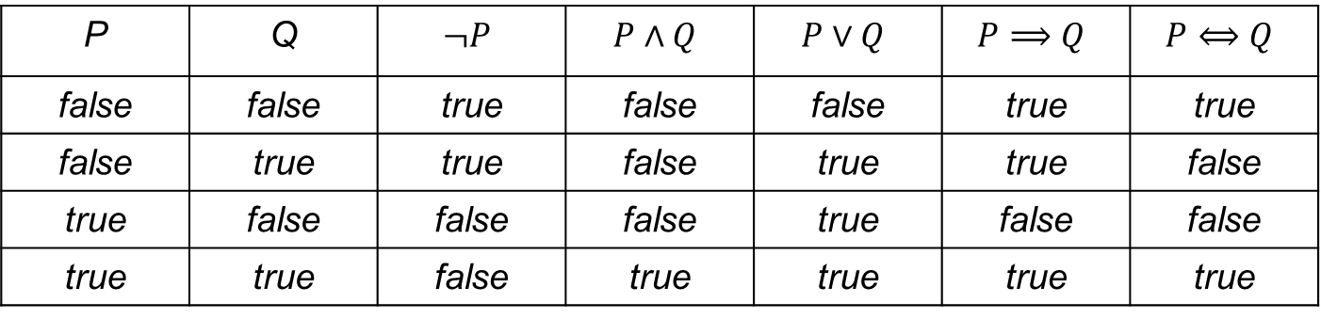
Truth tables for connectives （真值表）
P | Q | $$¬P$$ | $$P∧Q$$ | $$P∨Q$$ | $$P⟹Q$$ | $$P⟺Q$$
false | false | true | false | false | true | true
false | true | true | false | true | true | false
true | false | false | false | true | false | false
true | true | false | true | true | true | true

Slide 32
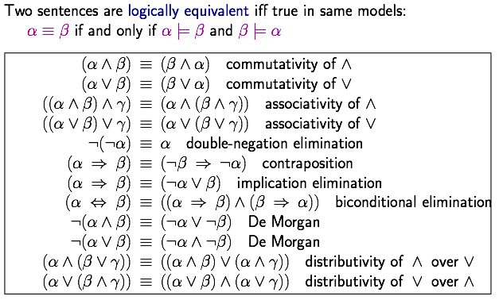
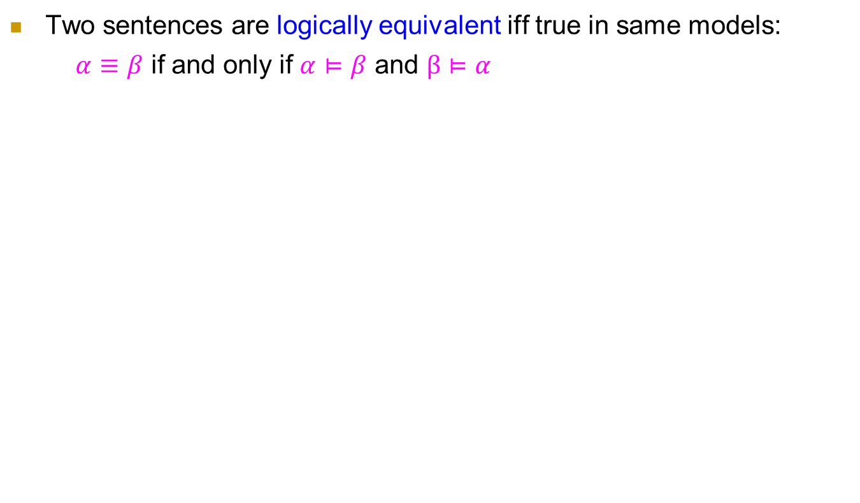
Logical equivalence (语义）
Two sentences are logically equivalent iff true in same models:
$α≡β$ if and only if $α⊨β$ and $β⊨α$
作业

Slide 33
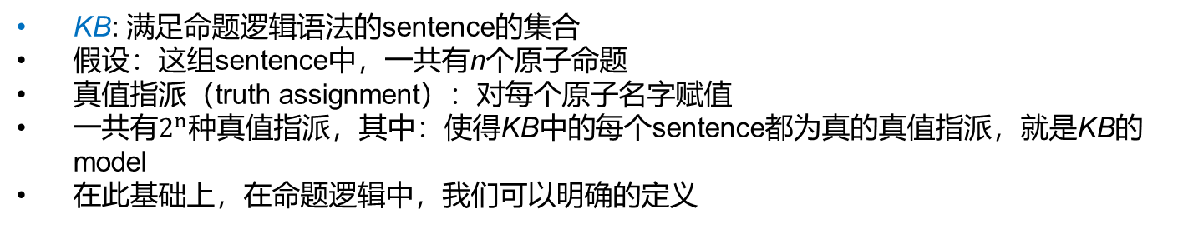
命题逻辑中的知识库KB
KB: 满足命题逻辑语法的sentence的集合
假设：这组sentence中，一共有n个原子命题
真值指派（truth assignment）：对每个原子名字赋值
一共有$2^{n}$种真值指派，其中：使得KB中的每个sentence都为真的真值指派，就是KB的model
在此基础上，在命题逻辑中，我们可以明确的定义

Slide 34
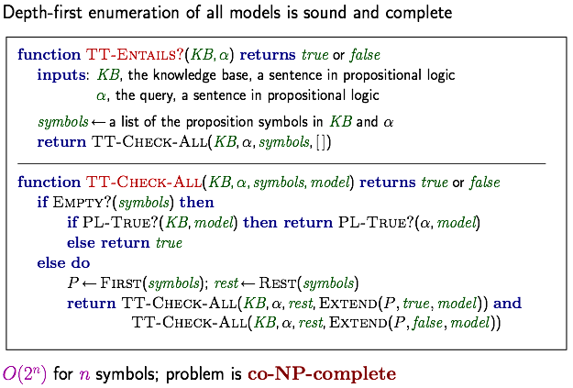
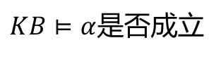
Inference by enumeration
$KB⊨α$是否成立
$$\text{Depth}\text{−}\text{first} \text{enumeration} \text{of} \text{all} \text{models} \text{is} \text{sound} \text{and} \text{complete}$$
$$O\left(2^{n}\right) \text{for} n \text{symbols}\text{; } \text{problem} \text{is} \text{co}\text{−}\text{NP}\text{−}\text{complete}$$

Slide 35
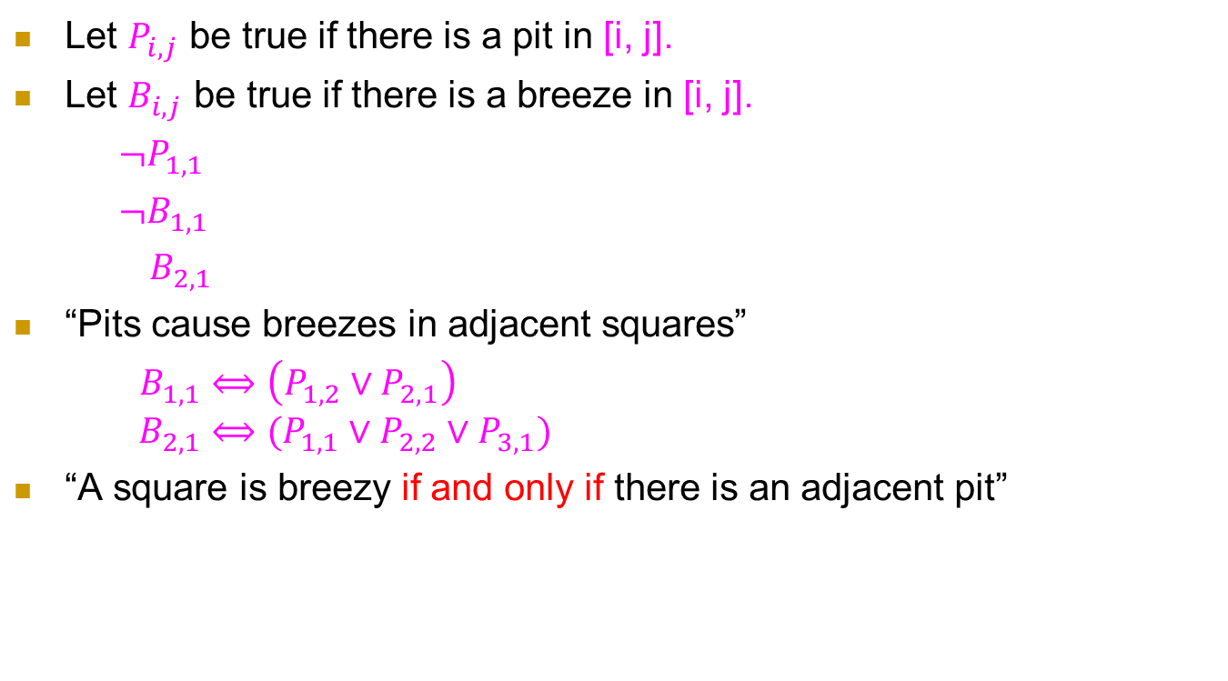
Wumpus world sentences
Let $P_{i,j}$ be true if there is a pit in [i, j].
Let $B_{i,j}$ be true if there is a breeze in [i, j].
$¬P_{1,1}$
$¬B_{1,1}$
$B_{2,1}$
“Pits cause breezes in adjacent squares”
$B_{1,1}⟺\left(P_{1,2}∨P_{2,1}\right)$
$$B_{2,1}⟺(P_{1,1}∨P_{2,2}∨P_{3,1})$$
“A square is breezy if and only if there is an adjacent pit”

Slide 36
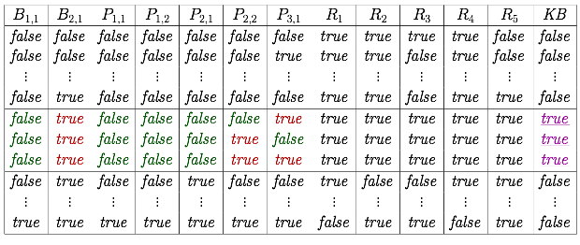
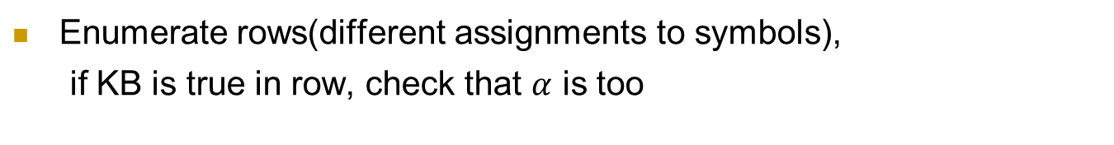
Truth tables for inference
Enumerate rows(different assignments to symbols),
if KB is true in row, check that $α$ is too

Slide 37
Entailment与implication的区别
Entailment: 逻辑上的概念，刻画两组sentence之间的关系
Implication: proposition之间的一种运算子，使用真值表刻画其语义

Slide 38
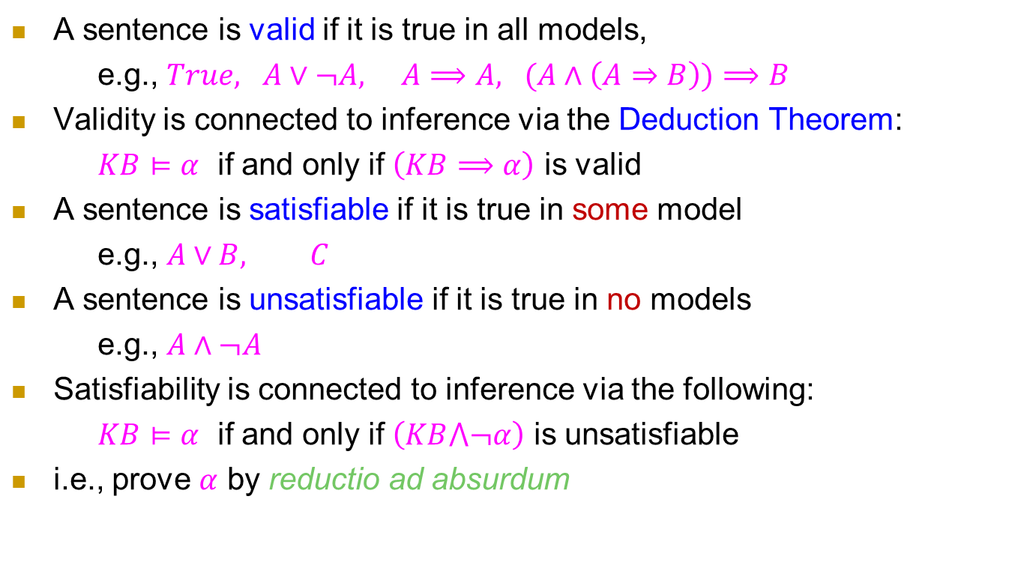
Validity and satisfiability
A sentence is valid if it is true in all models,
e.g., $True, A∨¬A, A⟹A, (A∧\left(A⇒B\right))⟹B$
Validity is connected to inference via the Deduction Theorem:
$KB⊨α$ if and only if $\left(KB⟹α\right)$ is valid
A sentence is satisfiable if it is true in some model
e.g., $A∨B, C$
A sentence is unsatisfiable if it is true in no models
e.g., $A∧¬A$
Satisfiability is connected to inference via the following:
$KB⊨α$ if and only if $\left(KB⋀¬α\right)$ is unsatisfiable
i.e., prove $α$ by reductio ad absurdum

Slide 39
形式推演 Deduction

Slide 40
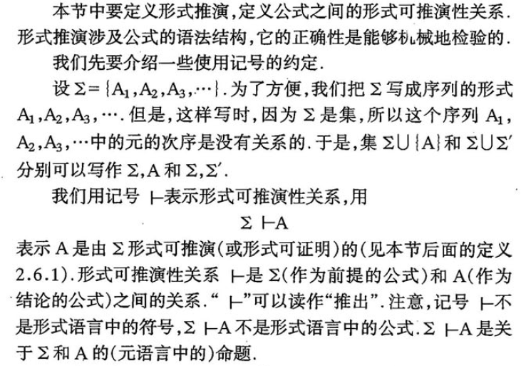
形式推演 Deduction
《面向计算机科学的数理逻辑》49页

Slide 41
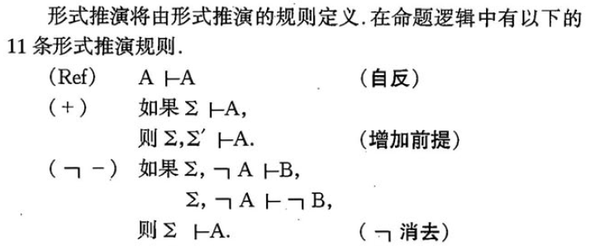
形式推演的11条规则（某一种推演系统）
《面向计算机科学的数理逻辑》49页

Slide 42
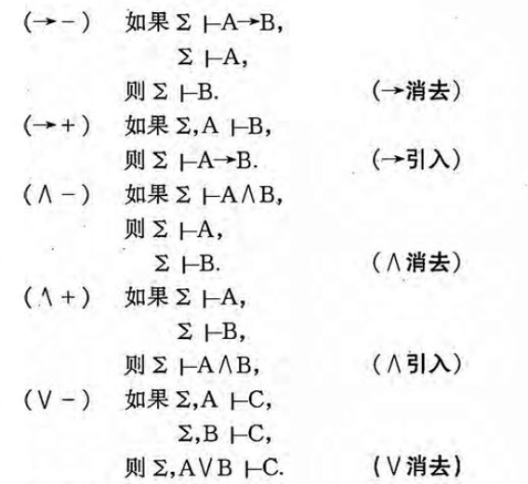
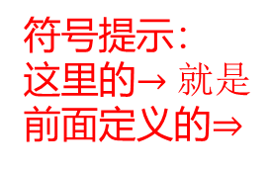
形式推演的11条规则
符号提示：
这里的$→就是$前面定义的$⇒$
《面向计算机科学的数理逻辑》49页

Slide 43
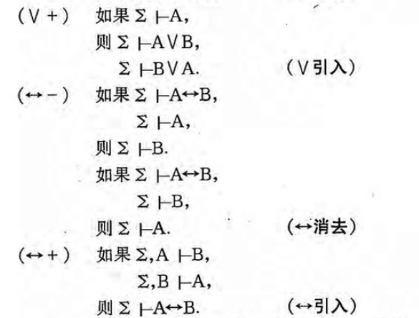

形式推演的11条规则
符号提示：
这里的$↔就是$前面定义的$⇔$
《面向计算机科学的数理逻辑》49页

Slide 44
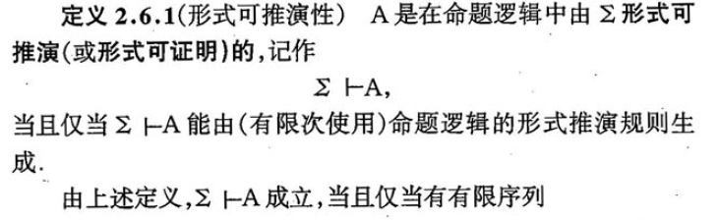

形式推演
《面向计算机科学的数理逻辑》53页

Slide 45

形式推演：例子
《面向计算机科学的数理逻辑》51页

Slide 46

逻辑推导 vs. 形式推演
《面向计算机科学的数理逻辑》55页

Slide 47

形式推演：例子
Homework：其余题目
《面向计算机科学的数理逻辑》59页

Slide 48

形式推演：例子
Homework：证明这些性质
《面向计算机科学的数理逻辑》63页

Slide 49
形式推演：常用的定理
定理2.6.3, 2.6.4, 2.6.5, 2.6.6, 2.6.7, 2.6.8, 2.6.9, 2.6.10,2.6.11
可以用基本的11条法则证明，它们则可以在其它证明中使用
《面向计算机科学的数理逻辑》

Slide 50



形式推演：Wumpus
$P_{x,y}$ is true if there is a pit in [x,y]
$W_{x,y}$ is true if there is a wumpus in [x,y]
$B_{x,y}$ is true if the agent perceives BREEZE in [x,y]
$B_{x,y}$ is true if the agent perceives STENCH in [x,y]
证明：$KB⊢¬P_{1,2}∧¬P_{2,1}$

Slide 51

形式推演：Wumpus
$$\text{Biconditional} \text{elimination} \text{from} R_{2}$$
$$R_{6}:\left(B_{1,1}⇒\left(P_{1.2}∨P_{2,1}\right)\right)∧\left(\left(P_{1,2}∨P_{2,1}\right)⇒B_{1,1}\right)$$
$$\text{And}-\text{elimination} \text{from} R_{6}$$
$$R_{7}:\left(P_{1,2}∨P_{2,1}\right)⇒B_{1,1}$$
$$\text{Contrapositive} \text{from} R_{7} \text{. }$$
$$R_{8}:¬B_{1,1}⇒¬\left(P_{1,2}∨P_{2,1}\right)$$
$$\text{Modus} \text{Ponens} \text{from} R_{8} \text{. }$$
$$R_{9}:¬\left(P_{1,2}∨P_{2,1}\right)$$
De Morgan‘s rule from $R_{9}$
$$R_{10}:¬P_{1,2}∧¬P_{2,1}$$
证明：$KB⊢¬P_{1,2}∧¬P_{2,1}$
证明过程并不是一个机械化的方法

Slide 52
Summary
逻辑系统
Syntax：formal structure of sentences
Semantics: truth of sentences wrt models; Entailment: necessary truth of one sentence given another
Deduction: formal deduction based on deduction rules

Slide 53


Inference
$$KB⊢_{i}α= \text{sentence} α \text{can} \text{be} \text{derived} \text{from} KB \text{by} \text{procedure} i$$
$$\text{Consequences} \text{of} KB \text{are} \text{a} \text{haystack}\text{; }α \text{is} \text{a} \text{needle}\text{. }$$
$$\text{Entailment} = \text{needle} \text{in} \text{haystack}\text{; }\text{inference} = \text{finding} \text{it}$$
$$\text{Soundness}\text{: }i \text{is} \text{sound} \text{if}$$
$$\text{whenever} KB⊢_{i}α, \text{it} \text{is} \text{also} \text{true} \text{that} KB⊨α$$
$$\text{Completeness}\text{: }i \text{is} \text{complete} \text{if}$$
$$\text{whenever} KB⊨α, \text{it} \text{is} \text{also} \text{true} \text{that} KB⊢_{i}α$$
$$\text{Preview}\text{: }\text{we} \text{will} \text{define} \text{a} \text{logic}\text{ (}\text{first}\text{−}\text{order} \text{logic}\text{) }\text{which} \text{is} \text{expressive} \text{enough} \text{to} \text{say} \text{almost} \text{anything} \text{of} \text{interest}\text{, }\text{and} \text{for} \text{which} \text{there} \text{exists} \text{a} \text{sound} \text{and} \text{complete} \text{inference} \text{procedure}\text{.}$$
$$\text{That} \text{is}\text{, }\text{the} \text{procedure} \text{will} \text{answer} \text{any} \text{question} \text{whose} \text{answer} \text{follows} \text{from} \text{what} \text{is} \text{known} \text{by} \text{the} \text{KB}\text{.}$$
哥德尔不完全 定理：在一个大的范围内（证明法和问题与正整数存在一一对应关系），不存在既sound又complete的inference过程

